Slide 1
NE 795-014: Advanced Reactor Materials
Fall 2023
Dr. Benjamin Beeler

Slide 2
High Temperature Gas reactors and TRISO Particles

Slide 3
High Temperature Gas Reactor
The HTGR has a long history going back to the earliest days of nuclear energy development
Commercial gas-cooled nuclear power for electricity production started in 1956 with the operation of the first 50 MWe unit in the UK
The design, which came to be known as Magnox, featured carbon-dioxide as the pressurized coolant and magnesium alloy cladding for the fuel
To raise thermal efficiency, later designs switched to stainless steel cladding, enriched uranium oxide fuel, higher CO2 pressures, and higher operating temperatures, in what came to be known as the Advanced Gas Reactor (AGR)

Slide 4
HTGRs
The use of helium (He) as a coolant was advocated as early as 1944 in a 5 MWt experimental reactor project, also featuring an indirect gas turbine cycle
Later, the prototype DRAGON reactor was put into operation in the UK in 1965 and featured a steel pressure vessel, coated fuel particles of highly-enriched uranium-thorium carbide and a helium outlet temperature of 750ºC

Slide 5
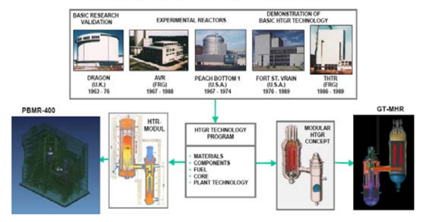
HTGRs
The substitution of He instead of air or CO2 provided excellent neutronic and thermal characteristics together with a graphite moderator
There are two mainstream HTGR design concepts; the prismatic core design and the pebble bed core design, both of which possess common advantages of the HTGR design such as inherent safety and high efficiency

Slide 6
Two types of HTGRs

Slide 7
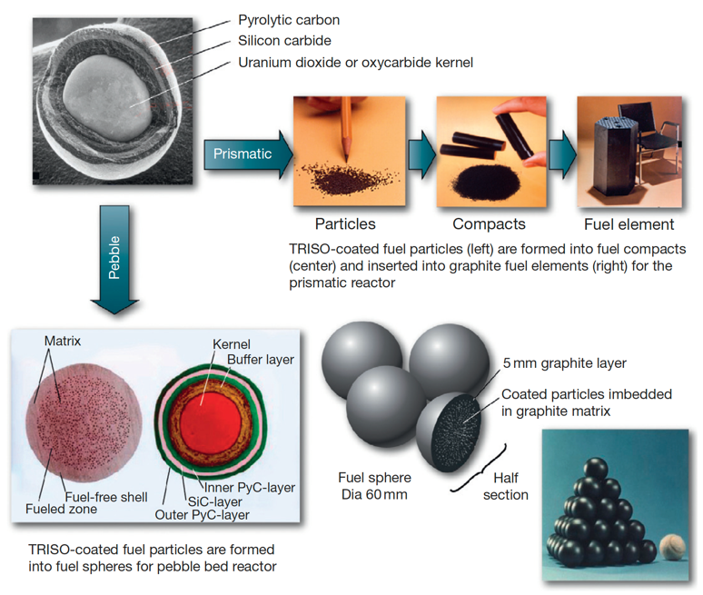

Slide 8
HTGRs
The main features of HTGRs are enhanced safety, high thermal efficiency, economical competitiveness, and proliferation resistance and these make this technology a potential candidate for the nuclear power plant deployment
One of the driving forces behind the HTGR philosophy is its utilization in the production of process heat: the high outlet gas temperatures may be utilized as a thermal heat source in endothermic chemical processes
Net thermal efficiencies greater than 45% are within the reach in some of the designs of HTGRs
The enhanced safety of the HTGR fuel is based on its coated fuel particle design consisting of uranium oxide/carbide particles coated with layers of pyrolytic carbon and silicon carbide
Coated particles are so designed that they can withstand high internal gas pressure without releasing any fission products to the environment

Slide 9
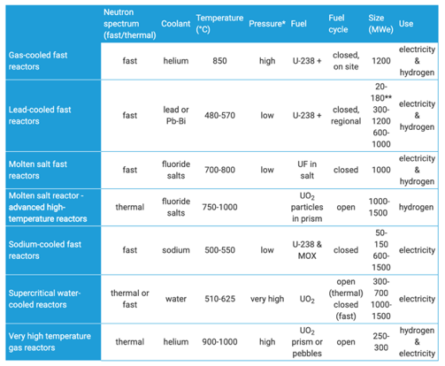
HTGRs
Difference from LWRs
helium cooled
much higher temperatures
thermal/fast options
extensive utilization of graphite
flexibility of fuel

Slide 10
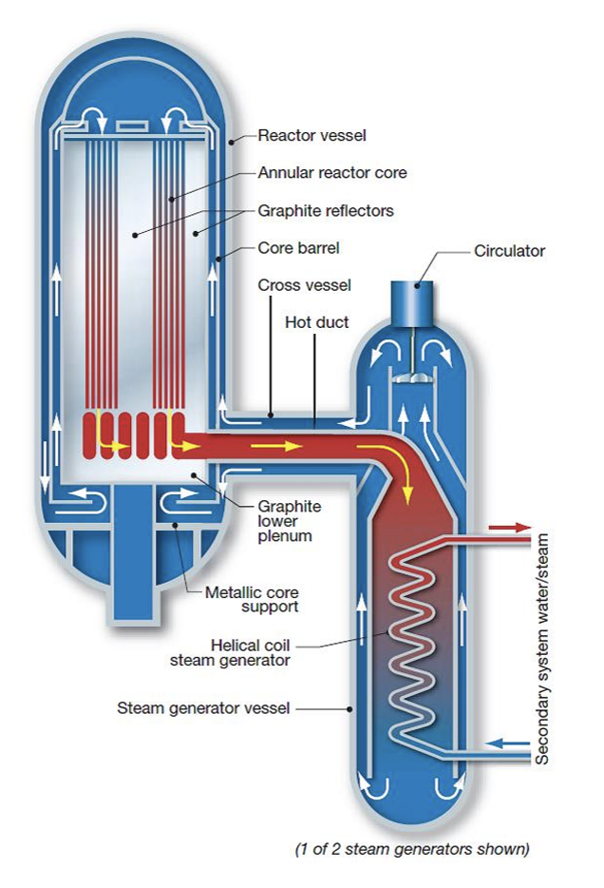
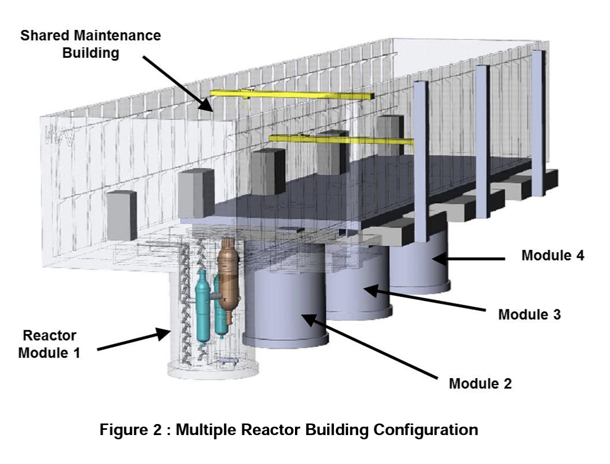
Framatome SC-HTGR
Steam Cycle High Temperature Gas-Cooled Reactor (SCHTGR)
Modular, graphite-moderated, helium-cooled, high temperature reactor with a nominal thermal power of 625 MWth
HALEU UCO fuel kernel in TRISO particles
Graphite hexagonal prism blocks
Core inlet: 350C; Core outlet: 750C

Slide 11
TRISO Particles
TRISO: TRistructural ISOtropic particle fuel
Layered fuel in mm-sized particles
Layers:
Fuel Kernel
Buffer
Inner Pyrolitic Carbon (IPyC)
SiC
Outer Pyrolitic Carbon (OPyC)

Slide 12
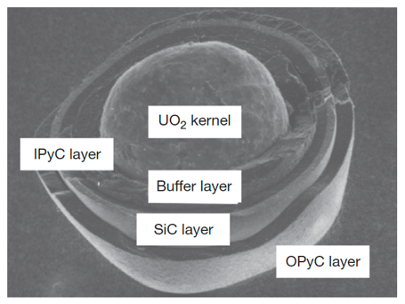
Fuel Kernel + Buffer
A variety of fissile and fertile kernels have been used in particles, including ThC2, ThO2, PuO2, (Th,U)O2, UC2, UO2, and UCO
Nominal fuel kernel diameters range between 100 and 500 microns
The fuel kernel is surrounded by a porous graphite buffer layer that absorbs fission recoils and allows space for swelling and fission gases produced during irradiation
The buffer layer is generally about 100-micron thick

Slide 13
IPyC-SiC-OPyC
Surrounding this inner buffer layer is a layer of dense pyrolytic carbon (IPyC), a silicon carbide (SiC) layer, and a dense outer pyrolytic carbon (OPyC) layer
The pyrolytic carbon layers protect the SiC layer, which is the pressure boundary
The pyrolytic carbon layers are approximately 40-micron thick; the SiC layer is usually about 35-micron thick
Each microsphere acts as a mini pressure vessel, which is designed to impart robustness to the gas reactor fuel system
TRISO diameter is typically ~750 microns

Slide 14
Early Concepts
A refractory material or refractory is a material that is resistant to decomposition by heat, pressure, or chemical attack, and retains strength and form at high temperatures
The concept of nuclear fuel microspheres with refractory coatings to contain fission products during operation in HTGRs can be traced to the Dragon Project in the 1950s
The earliest versions involved fuel kernels coated with only a single pyrolytic carbon layer intended to protect the kernel during fabrication, this rapidly evolved in the following decade into more complex and more effective particle designs
It was recognized almost from the beginning that the coating layers could provide some degree of advantageous fission product retention when properly designed
(a) BISO particle, (b) Particles with “laminated” pyrocarbon layer structure, (c) Particle with “Triplex” structure, (d) Fertile (Th,U)C2 with of PyC-SiC-PyC structure, (e) Carbide particle with single PyC coating, (f) “Duplex” (Th,U)C2 particle

Slide 15
Early Failure
Fracturing of the pyrocarbon layer in these particles during irradiation was found to be a concern
Causes included kernel swelling, radiation-induced pyrocarbon dimensional change, damage from fission recoils, fission gas pressure, and chemical reaction of fission products with the coating
A design modification was the introduction of a sacrificial layer of pyrocarbon between the kernel and the dense, outer pyrocarbon layer
This two-layered particle design was termed “BISO” for Buffer-isotropic

Slide 16
Transition to TRISO
The notion that refractory ceramics, could provide significantly improved particle strength and retention of fission products compared to pyrocarbon alone was suggested near the very beginning of coated particle development
This led to the addition of a silicon carbide layer placed between two layers of dense pyrocarbon
This SiC layer, along with the porous buffer layer of BISO particles, formed the basis for the modern TRISO coating design

Slide 17
fuel kernel

Slide 18
Fuel Kernel
Coated particle fuel allows flexibility in kernel material, the porous buffer layer mechanically decouples the kernel from the outer coating, accommodating some degree of kernel swelling
Choice of kernel material is influenced by fabrication concerns, kernel behavior under irradiation, and reactor design
Early designs primarily included fertile carbide fuels (ThC)
Carbide kernels have excellent high-temperature compatibility with the surrounding graphite fuel elements
However, oxide kernels simplify the overall fabrication process (don’t have to worry about oxidation) and maintain better chemical stability during the high temperature heat treatment of fuel pebbles during manufacture

Slide 19
Fuel Chemistry
An important consequence of UO2 fission is the creation of free oxygen since only a part of the O2 recombines with the fission products
In the TRISO particle, a portion of this free oxygen combines with carbon from the buffer/PyC coatings to form CO and CO2 gases
Identification of those compounds (solid and gaseous) that can form in fuel during normal and off-normal conditions and which elements remain in elemental form, is known as fuel chemistry
Changes in fuel chemistry may lead to many important mechanisms affecting fuel performance, e.g., kernel size (swelling), kernel migration (amoeba effect), stresses in the coatings (particle pressurization due to fission products and carbon oxide gases), thermal conductivity, creep properties modification, etc.
The oxygen potential, the pressure of oxygen in the gas phase within the fuel, is the critical parameter determining which elements in their competition for oxygen form oxides

Slide 20
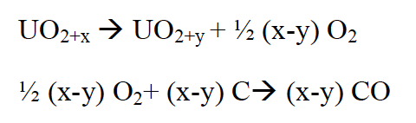
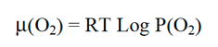
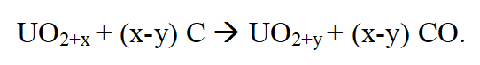
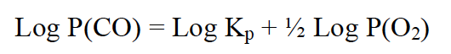
Oxygen Potential
Calculation of the oxygen potential is complex since it generally varies with distance from the particle center and with temperature, fuel burnup, fission product yields, chemical state of fission products including solid and gas phases, and the effectiveness of the coating layers to absorb fission products and oxygen
The oxygen potential is represented by:
where P(O2) is the oxygen partial pressure, R is the gas constant, T is the temperature
In fresh fuel (simpler case), where we assume the fuel reaches thermodynamic equilibrium with its surrounding coatings, the main product of the reaction between UO2+x (x>0) and carbon is gaseous carbon monoxide, CO, by the following reactions:
which can be rearranged as:
Utilizing an equilibrium rate constant K,

Slide 21
Oxygen Potential
Reactions to generate CO2 are also possible, but at applicable temperatures and values of the oxygen potential, CO production dominates
As the oxygen potential, i.e. oxygen partial pressure, is increased we are generating more CO
The result of CO formation is internal pressurization of the particle which may lead, in extreme conditions, to particle failure
To limit this pressurization other fuel kernel concepts have been and are being studied, of particular interest is the oxycarbide fuel (or UCO) comprising a mixture of UC2 and UO2
Gas formation is effectively reduced within the UCO particle as compared to a UO2 particle due primarily to their lower oxygen inventory
Additionally, there is a gettering effect of the UC2 on the oxygen released during UO2 fission which forms a condensed oxide rather than CO gas

Slide 22
CO Pressurization
The result of CO and CO2 formation is internal pressurizing of the particle that increases with burnup and adds to the pressurization from fission gases
At lower burnup (≤ 6 % FIMA), pressurization of the particle arises principally from fission-gas release from the fuel kernel
At higher burnup (9% FIMA, at 1450 K), the pressure resulting from fission gases can represent half of the contribution of CO and CO2 in an HTGR TRISO coated particle
The suppression of excessive CO formation during oxidation of a UO2 based particle remains an important design objective at moderate and high burnup
The failure of the SiC layer may happen because of over-pressurization due to CO formation
CO and CO2 pressures are suspected of being partly responsible for the mechanical weakening of the IPyC coating, and corrosion of the SiC layer by CO can occur as a result from failure of the IPyC coating

Slide 23
Uranium Oxycarbide (UCO)
Work in the US retained the carbide kernel design, because the HTGR designs of required high peak fuel temperatures and high power densities that would result in excessive kernel migration
UC fuel, no worries about CO production
However, it was found that rare earth fission product elements migrating from carbide kernels during irradiation could chemically attack the SiC layer of TRISO particles and compromise the structural integrity

Slide 24
UCO
We have two fuel kernel problems:
CO production (UO2)
fission product release (UC)
This led to the suggestion of a kernel comprised of a mixture of both oxide and carbide phases
Thus, a design was made to include sufficient UC2 to getter the excess oxygen produced by UO2 fission
UCO avoids the formation of CO, while still taking advantage of the retention of the metal oxide fission products in the predominantly UO2 kernel
The success of UCO kernels by the US program lead to the adoption of UCO fuel as the reference fissile particle design by the early 1980s, with an approximate UO2/UC2 mixture of 80/20

Slide 25
U-C Phases
UC2 has a fcc fluorite structure at high temperature and transforms to a body-centered tetragonal structure at 1820C
The UC2 phase is retained in a metastable form in material rapidly cooled from the melt
As-cast hyper stoichiometric UC consists of a Widmanstatten pattern of UC2 platelets on the {100} planes of the face-centered cubic UC matrix

Slide 26
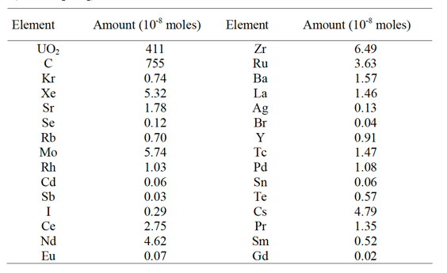
Fission Products
The rate of change of each nuclide is a function of three processes:
depletion of heavy nuclei by fission and corresponding production of lighter nuclei (fission products)
production by radioactive decay (actinides and fission products) and/or by neutron capture (actinides)
loss by radioactive decay (actinides and fission products) and/or by neutron capture (actinides)
Element inventory for a UO2 kernel @ 5.5% FIMA on the right

Slide 27
Fission Products
Fission products in UO2 are primarily located as substitutional atoms, commonly paired with additional vacancies
A large number of fission products are highly insoluble in UO2, including Xe, I, and Br
Some solubility exists for transition metals such as Zr and alkaline metals such as Sr, and high solubility exists for some rare earth elements, such as Ce
Fission products in the fuel lattice can diffuse out of the UO2 to grain boundaries
The diffusion mechanism depends on the nature of the fission product trap sites and on the fission product intrinsic characteristics
Irradiation effects can greatly enhance or reduce this diffusion by trapping mechanisms on extended

Slide 28
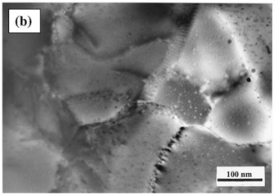
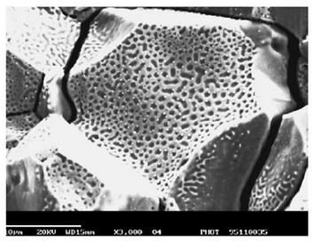
Fission Products
The fission gases precipitate primarily as intragranular bubbles which can grow by gas-atom and vacancy absorption
Fission gases can migrate to grain boundaries by atomic or bubble diffusion to form intergranular bubbles where they can grow by addition of gas and vacancies
Fission-rate helps to strongly limit bubble size and maintain a substantial fission-gas atom population in the fuel lattice by re-solution of gas from bubbles
Once intergranular-bubble growth becomes significant causing interconnection of porosity, a path from within the kernel to the buffer is created leading to fission-gas release by a percolation mechanism

Slide 29
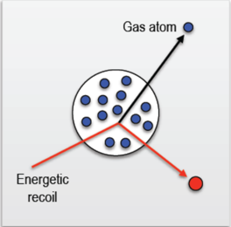
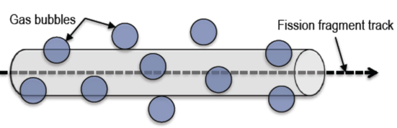
Bubble Resolution
Homogeneous resolution
individual gas atoms are ejected from the gas bubble through collisions with energetic fission fragments or recoil uranium atoms
Heterogeneous resolution
bubble are almost completely destroyed by the passage of a fission fragment

Slide 30
Fission Product Chemistry
Rare earth elements have high solubility in UO2 and form rare earth oxides (REOs)
Zr, Nb and Sr have significant solubility in UO2 and oxidize to form ZrO2, Nb2O3 and SrO
Fission products that either have lower solubility or are less likely to form stable oxides, such as Ba, Te and Mo, diffuse to the grain boundaries and form perovskite or intermetallic precipitates
These grain boundary inclusions can allow for release from the fuel kernel
Ag and Pd are known to form intermetallic precipitates and are readily release from the fuel kernel
Ellingham diagram showing the temperature dependence of the stability of compounds

Slide 31
Fission Product Carbides
In the UCO-type fuel kernel, oxygen liberated during the fission process of UO2, first oxidizes the carbide UC2 phase and then the RE fission products because of their high affinity for oxygen
Those fission product elements with lower affinity for oxygen (Sr, Eu, Zr, Ba) exist as carbide compounds
As the burnup increases, the UC2 phase in the kernel decreases
When UC2 has fully disappeared, the oxygen potential then increases and oxygen is available to form oxide compounds with these fission products
Oxidation diagram for carbides of interest

Slide 32
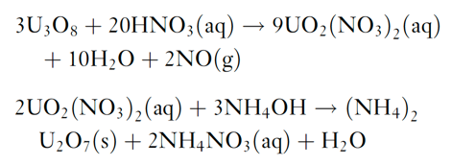
Fuel Kernel Fabrication
The sol–gel technique for kernel microsphere preparation is based on the following two chemical reactions starting from U3O8 powder
The (NH4)2U2O7 (ammonium di-uranate – ADU) is converted to UO2 by sintering in hydrogen gas
For the production of UCO kernels, carbon black is added to the broth and the sintering is performed in CO gas to ensure adequate C/O stoichiometry

Slide 33
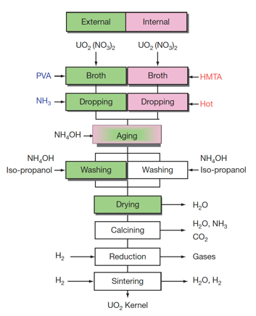
Fuel Kernel Fabrication
The mechanical strength of the coated layers depends on their thickness and sphericity, and thus strongly depend on the diameter and sphericity of the kernels
Vibrating nozzles from which droplets are emitted with high speed were developed for uniform and spherical kernel fabrication
A process is applied to prevent the deformation of droplets while they are landing on the ammonia water, where droplets are solidified while falling in ammonia gas blown against them

Slide 34
Fuel Kernel Summary
Flexible composition, allowing for commercial power, fertile, breeder, and burner options
Carbide and Oxide options
Carbides allow for higher power density and higher temperatures, reduce CO production
Oxides retain fission products
US utilizes UCO 80(UO2)/20(UC2) mix

Slide 35
Questions?

